Slide 1

BCDS Data Architecture
Draft for Review
13th January 2016

Slide 2
Agenda
Review BCDS Data Lifecycle (Platform Only)
Review Conceptual Data Model (CDM)
Review Logical Data Model (RBAC Subject Area Only)

Slide 3
BCDS Data Lifecycle
Data Acquisition
Claims Data
Ingested Models
Temporal Data
Rating Determination Engine
Data Processing & Mgt
(Model Repository)
Data Delivery
(Reporting)
Model
Mgt & Data Integration
Component | Component Description | Technology Options
Data Acquisition | A logical data repository responsible for staging of data and preparation of data and predictive models before processing | HDFS Oracle XML Files Scripts CSV Files
Data Processing & Mgt | A logical data repository responsible for persisting Ear & Knee predictive models and the associated data for operation of BCDS Application | Oracle MongoDB
Data Delivery | A logical data repository responsible for persisting the results of a ratings determination for reporting purpose | Oracle

Slide 4
BCDS Data Lifecycle
Data Acquisition
Target Claim
Data Processing & Management
Claimant Data
User Management
(Users, Roles, Permissions)
Data Delivery
Model Repository
Model Processing (Engine)
Modeling Results
Output Directories, digital output staging

Slide 5
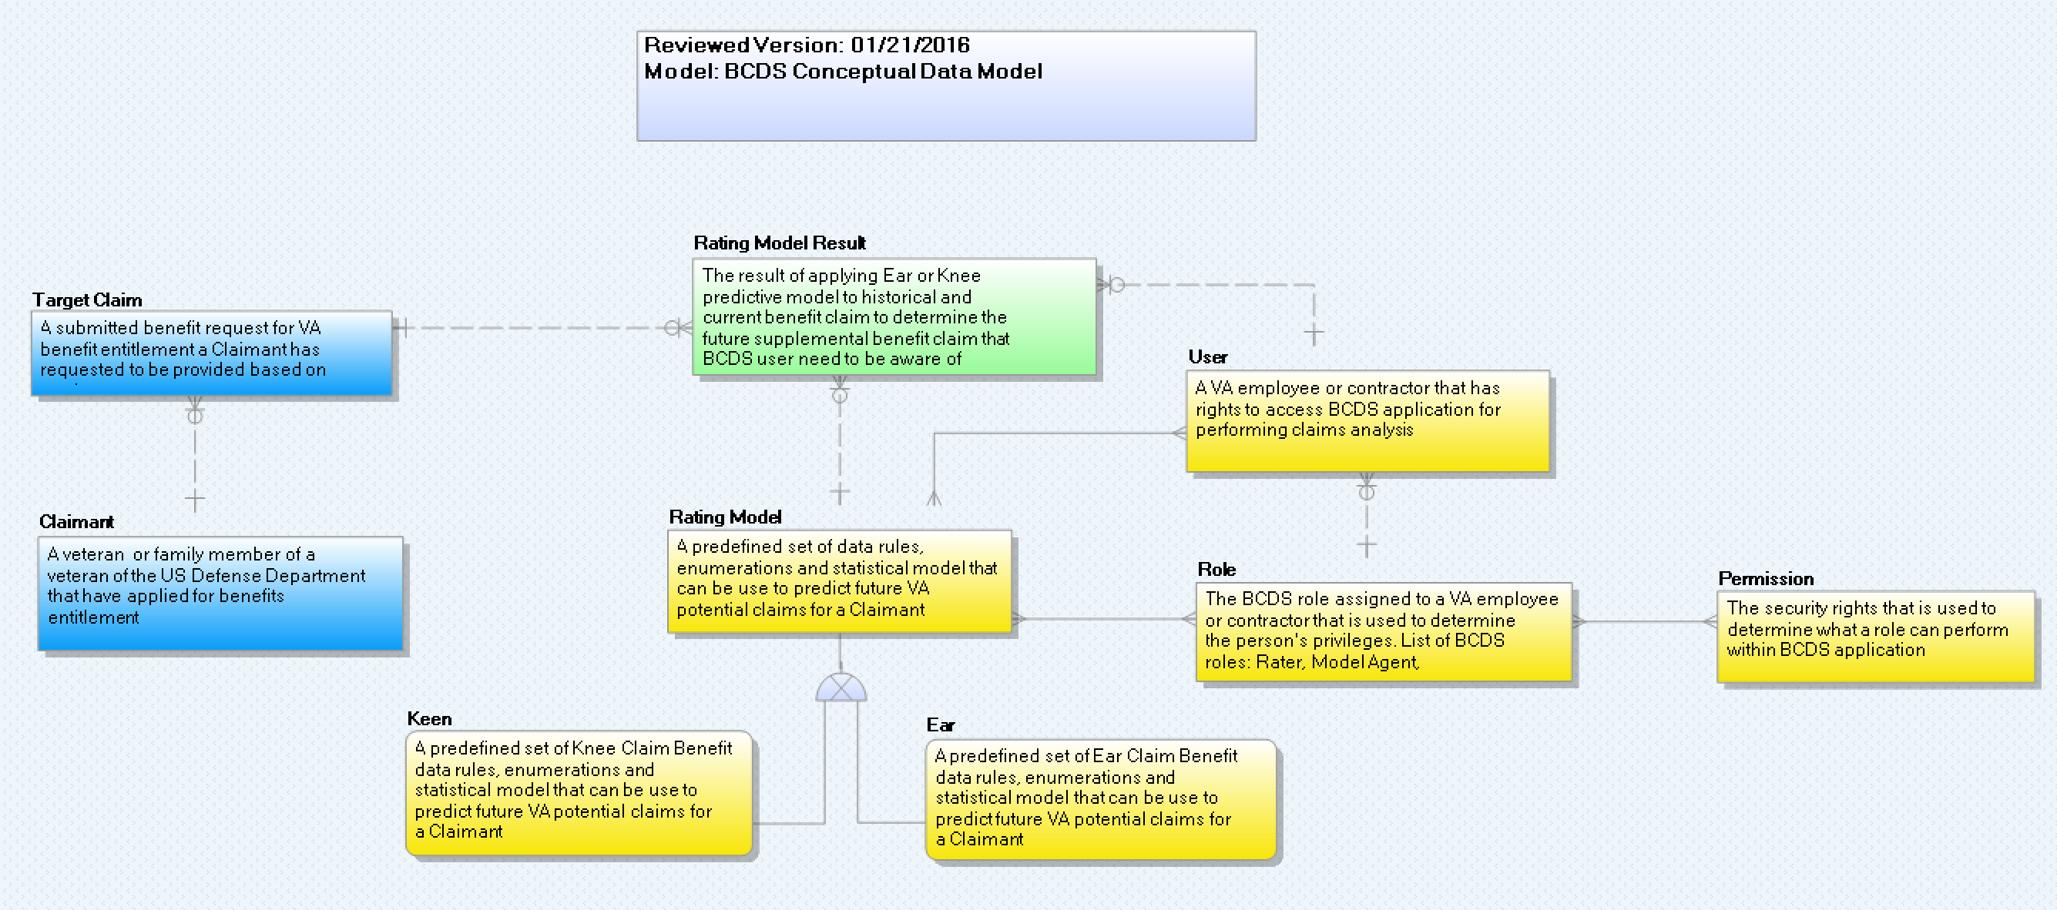
BCDS Conceptual Data Model (CDM)

Slide 6
CDM Data Dictionary
Entity Name | Object Type | Definition
User | Entity | A VA employee or contractor that has rights to access BCDS application for performing claims analysis
Ear | Entity | A predefined set of Ear Claim Benefit data rules, enumerations and statistical model that can be use to predict future VA potential claims for a Claimant
Keen | Entity | A predefined set of Knee Claim Benefit data rules, enumerations and statistical model that can be use to predict future VA potential claims for a Claimant
Rating Model | Entity | A predefined set of data rules, enumerations and statistical model that can be use to predict future VA potential claims for a Claimant
Target Claim | Entity | A submitted benefit request for VA benefit entitlement a Claimant has requested to be provided based on service
Claimant | Entity | A veteran or family member of a veteran of the US Defense Department that have applied for benefits entitlement
Role | Entity | The BCDS role assigned to a VA employee or contractor that is used to determine the person's privileges. List of BCDS roles: Rater, Model Agent, Administrator, Modeling Analyst
Rating Model Result | Entity | The result of applying Ear or Knee predictive model to historical and current benefit claim to determine the future supplemental benefit claim that BCDS user need to be aware of
Permission | Entity | The security rights that is used to determine what a role can perform within BCDS application

Slide 7
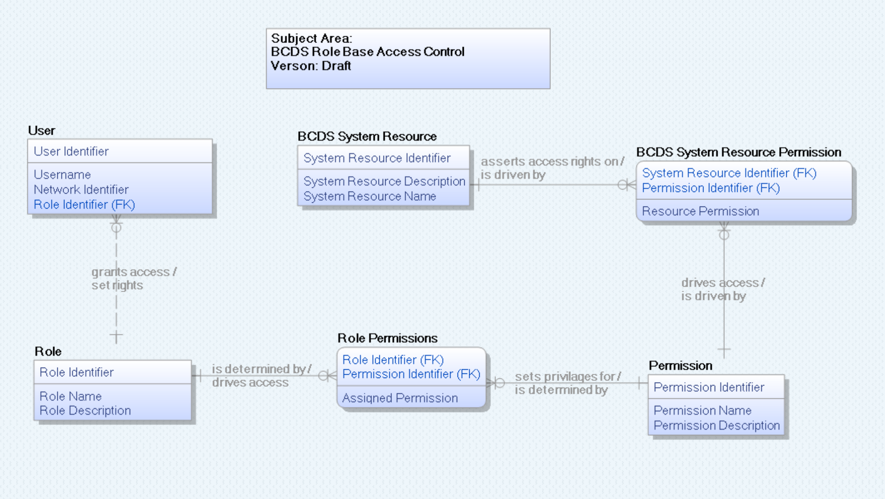
BCDS LDM – Security Only

